Slide 1
Mobile Application Development
User Interface Layout

Slide 2
User interface Terminologies
Orientation: The orientation of the screen from the user's point of view. There are two screen orientation:
landscape orientation has a wide screen's aspect ratio while
Portrait orientation has a tall screen's aspect ratio
different devices operate in different orientations by default, and the orientation can change at runtime when the user rotates the device.

Slide 3
User interface Terminologies
Resolution: The total number of physical pixels on a screen.
Screen size is the Actual physical size, measured as the screen's diagonal. For simplicity, Android categorizes all actual screen sizes into four generalized sizes: small, normal, large, and extra large.

Slide 4
User interface Terminologies
Screen density : The quantity of pixels within a physical area of the screen; usually referred to as dpi (dots per inch).
Android categorizes screen densities to low, medium, high, and extra high.
a "low" density screen has fewer pixels within a given physical area, compared to a "normal" or "high" density screen.

Slide 5
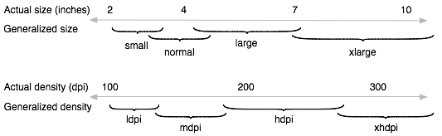
User interface Terminologies
Illustration of how Android roughly maps actual screen sizes and screen densities to generalized sizes and densities (figures are not exact).

Slide 6
User interface Terminologies
Density-independent pixel (dp): A virtual pixel unit that should be used when defining UI layout, to express layout dimensions or position in a density-independent way.
The dp is equivalent to one physical pixel on a 160 dpi screen, which is the baseline density assumed by the system for a "medium" density screen.
At runtime, the system transparently handles any scaling of the dp units, as necessary, based on the actual density of the screen in use.

Slide 7
User interface Terminologies
Android categorizes all density-independent pixel (dp) sizes into four generalized sizes: small, normal, large, and extra large.
xlarge screens are at least 960dp x 720dp
large screens are at least 640dp x 480dp
normal screens are at least 470dp x 320dp
small screens are at least 426dp x 320dp

Slide 8
User interface Terminologies
The formula for converting dp units to screen pixels is as follows:
px = dp * (dpi / 160).
For example, on a 240 dpi screen, 1 dp equals 1.5 physical pixels.
dp units are used when defining application's UI, to ensure proper display of UI on screens with different densities.

Slide 9
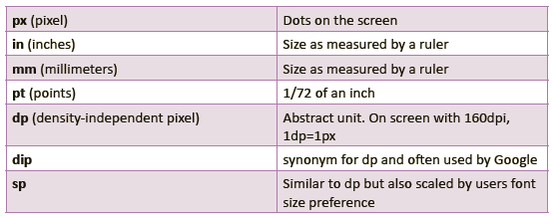
Units for specifying user interface
The following table shows a list of units that are used to specify dimensions of user interface

Slide 10
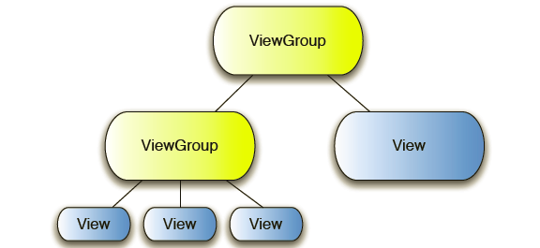
User Interface Layout
The user interface layout of android application is defined using a hierarchy of Views and ViewGroups
In a single android user interface, Views and View groups are organized into a hierarchical tree structure.
View groups are placed at the root and intermediate positions of the tree while Views are placed at leaf nodes of the tree.
A single user interface can only have one root element

Slide 11
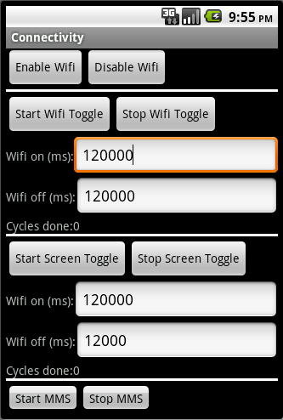
View
A View is a class that draws user interface(UI)objects on the screen that the user can interact with.
Examples of View objects:
  TextFields
  EditFields
  Buttons
  Checkboxes
  RadioButtons
  etc.

Slide 12
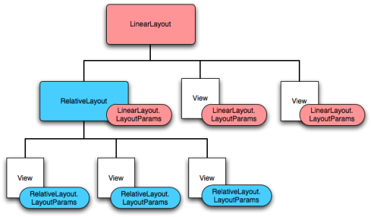
View group
A ViewGroup is a class draws that container for holding views including other viewgroups in order to organize the layout of the interface. For Example Layouts.

Slide 13
XML structure for Views and View groups
The xml structure of a user interface for an activity is organized in the following format:
<view group>
<view> </view>
<view group>
<view> </view>
<view> </view>
<view/>
</view group>

Slide 14
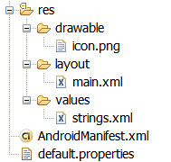
Example of view Group: Layouts
A Layout is a type of ViewGroup that holds all the visual elements (View objects) that appear to the user.
Its main purpose is to act as a container for holding and organize other visuals elements (controls) such as text controls or buttons or images on the screen.
Layout resources are stored as XML files in the /res/layout resource directory for the application.

Slide 15
Examples of layout
The most common layouts provided by Android are :
LinearLayout:
FrameLayout
RelativeLayout
TableLayout:
Tab layout

Slide 16
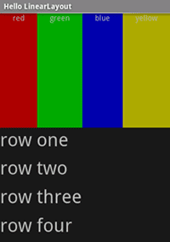
1. LinearLayout:
Linear layout arranges controls (its children) in a single
column or single row.
.
Controls can be aligned in one of the following direction.
1. Horizontallist will only be one row high (the height of the tallest child, plus padding).
2. Verticallist will only have one child per row, no matter how wide they are,
Linear layout is the most common layout

Slide 17
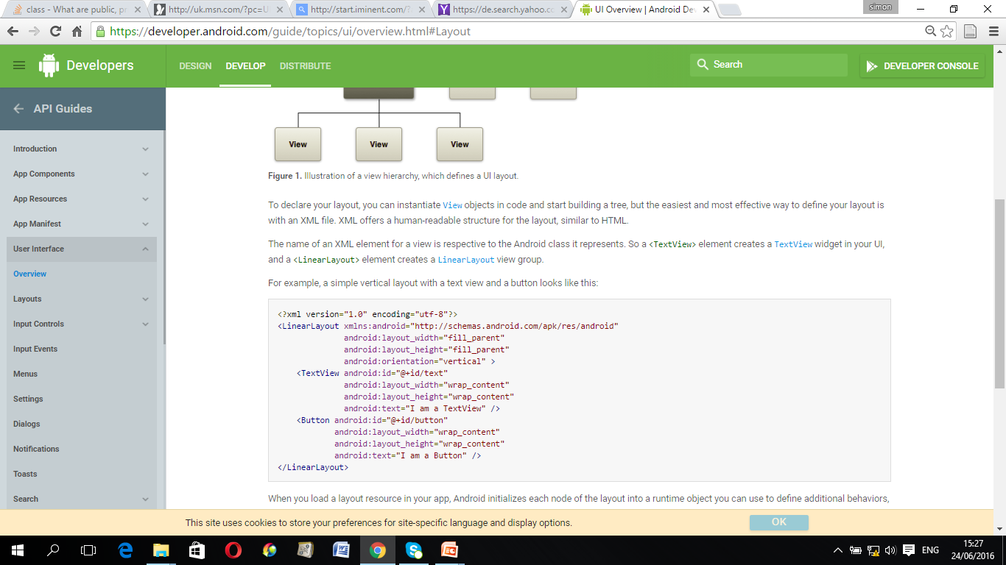
1. Linear Layout: XML File
Example : The following XML code shows linear layout as the root view group with a text view and a button

Slide 18
1. Linear Layout: XML File
XML code in this example can be explained as follows
<?xml version="1.0" encoding="utf-8"?>
Specify the XML version number(1.0) and used for
character encoding standard (utf-8) used in the document.
UTF-8 stands for Universal character set Transformation Format, which uses 1 byte (8-bits) to represent characters in the ASCII set, and two or three bytes for the rest.

Slide 19
1. Linear Layout: XML File
<LinearLayout > defines the beginning of linear layout file
</LinearLayout> defines the end of linear layout file
xmlns:android=http://schemas.android.com/apk/res/android
The file declares Java package for the application attribute known
as android, which is considered as that root of the application.

Slide 20
1. Linear Layout: XML File
android:layout_width="fill_parent“
Assigns layout width is equal with a width of the screen
assigns layout height with a height of the screen
android:layout_height="fill_parent“
This means that the height and the width of the layout will be proportional to the screen
Match_ parent value can also be used instead of fill_parent in API Level 8 and higher
Example :
android:layout_width="match_parent"
android:layout_height="match_parent“

Slide 21
1. Linear Layout: XML File
android:orientation="vertical“
Declares the orientation attribute and initializes it with a value for vertical direction
This means that all children will be aligned vertically
All children are stacked one after the other such that a vertical list will only have one child per row, no matter how wide they are
Example

Slide 22
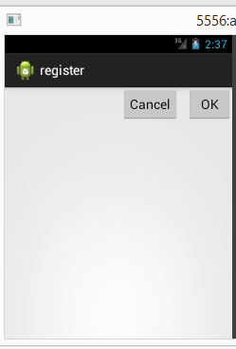
2. RelativeLayout
Arranges view objects ( its children) in
relation to each other or to the parent.
For Example,
If the first control is centered in the
screen, other controls
will be aligned relative to screen
center
Relative layout is often used to create forms.

Slide 23
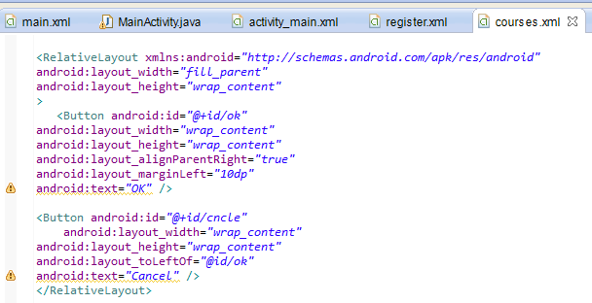
2. RelativeLayout Example
Example: XML file with Relative layout

Slide 24
2. RelativeLayout Example
Element in this example can be explained as follows:
android:layout_height="wrap_content“
android:layout_width ="wrap_content“
Sets the height of a container (i.e group view) to height of its contents (children).
This means that its height and width will expand only far enough to contain its contents such as text or other child controls in it.

Slide 25
2. RelativeLayout Example
The children of the layout are identified by their unique dentity values.
For example:
Button android:id= "@+id/ok“
Button android:id= "@+id/cncle“
In this example "@+id/ok“ and "@+id/cncle“ values are used to identify individual command buttons contained in the layout.
The plus-symbol (+) means that this is a new resource name that must be created and added in application resources (in the R.java file).

Slide 26
2. RelativeLayout Example
android:layout_alignParentRight ="true“
Aligns the control to the right of the parent (e.g layout)
android:layout_toLeftOf="@id/ok“
Aligns a control to the left of another control with
A unique identity /ok (in this case ok button)
android:layout_marginLeft ="10dp“
Aligns the control to 10 Density-independent pixel (dp)s from the
Left margin:

Slide 27
3. RelativeLayout Example
Example output

Slide 28
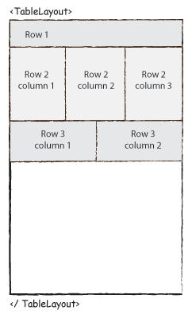
4. TableLayout:
Table layout arranges controls (its children) in rows and columns, similar to an HTML table
Each row has zero or more cells, each of which is defined by any kind of other View.
So, the cells of a row may be composed of a variety of View objects, like ImageView or TextView objects.

Slide 29
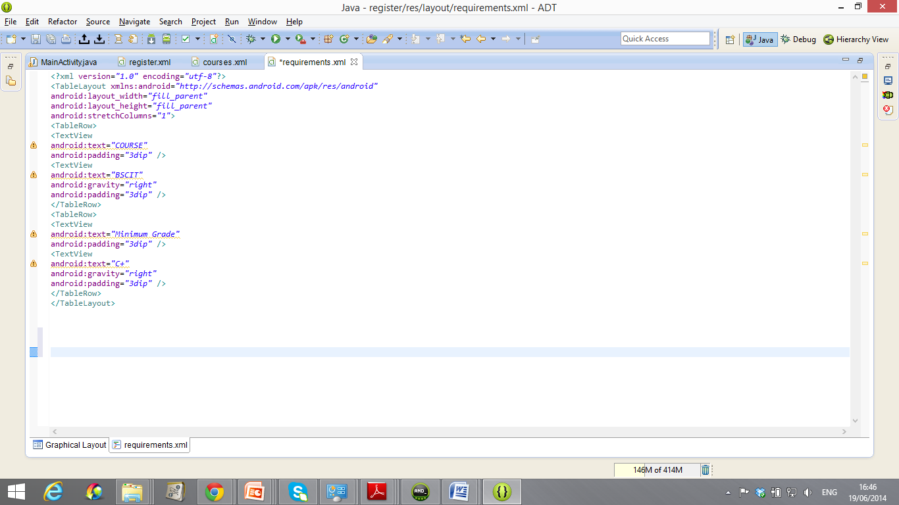
6. TableLayout: XML Example

Slide 30
6. TableLayout: XML Example
<TableLayout> element defines the beginning of a table layout
</TableLayout> element defines the end of a table layout
<TableRow> element specifies beginning of a table row
</TableRow> element defines end of a table row

Slide 31
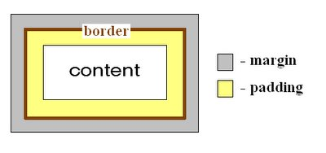
6. TableLayout: XML Example
android:padding="3dip”
Sets the size of the space between the view border and its contents.
In TextView padding is shifting a text inside it, but in a Layout view padding is shifting all layout elements .

Slide 32
6. TableLayout: XML Example
android:gravity=“ "
positions the contents of that view (i.e. what’s inside the view) on the right side
    In this example, android:gravity="right“ positions "BSCIT“ and "C+“ values on the right side of text views
  alternatively
android:layout_gravity can be used to position the view with respect to its parent (i.e. what the view is contained in).
E.g
android:layout_gravity="right“
This statement positions the view on the right side of the layout

Slide 33
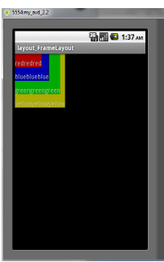
6. FrameLayout:
FrameLayout creates a blank space on the screen that can be filled with a single object
For example, a picture that you'll swap in and out.
All its children(controls) start at the top left of the screen.
you cannot specify a different location for a child view.
Subsequent child views will simply be drawn over previous ones, partially or totally Obscuring them (unless the newer object is transparent).

Slide 34
6. FrameLayout:
Generally, FrameLayout should be used to hold a single child view, because it can be difficult to organize child views in a way that's scalable to different screen sizes without the children overlapping each other.
It is FrameLayout is mostly used for tabbed views and image switchers.

Slide 35
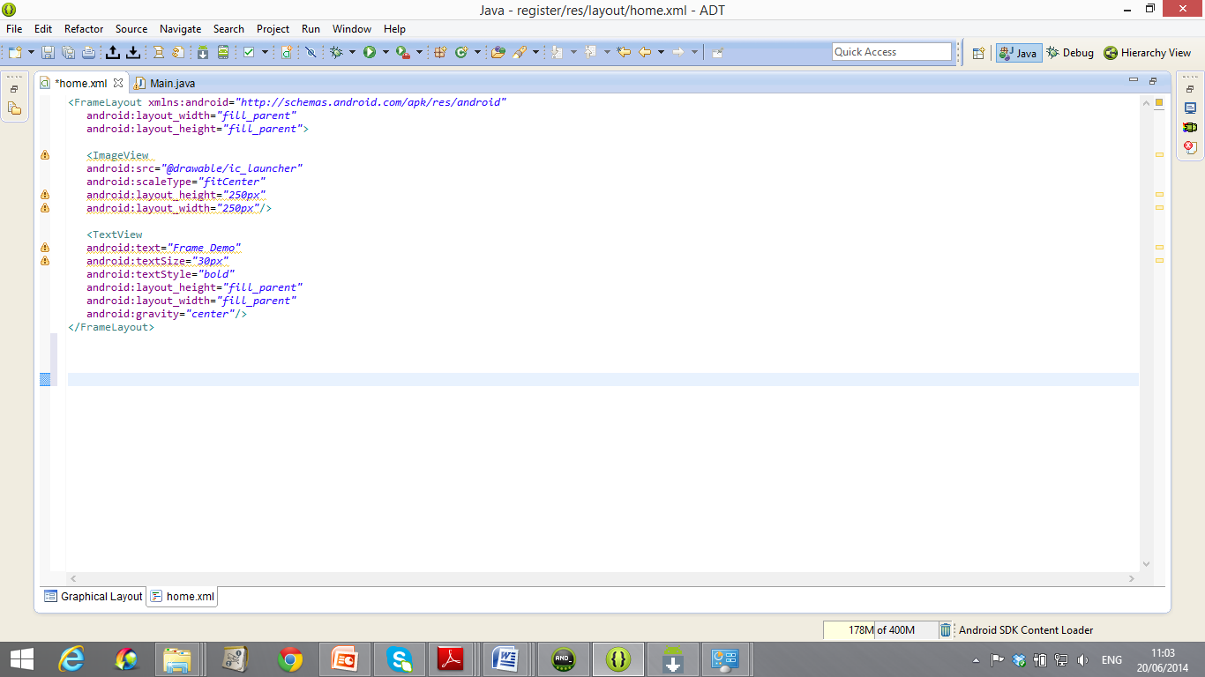
2. FrameLayout: Example

Slide 36
2. FrameLayout: Example
XML code in this example can be explained as follows:
android:layout_width="fill_parent“
android:layout_height="fill_parent“
Sets layout height and width to the height of the screen
android:src="@drawable/ic_launcher"
Assigns "@drawable/ic_launcher" image to src attribute

Slide 37
2. FrameLayout: Example
android:text="Frame Demo“
Assigns “Frame Demo“ value to Text attribute
android:scaleType="fitCenter“
Adjust the object to fit at the center of its container proportionally.
In this example, the object is “ ic_launcher” image and the container is <Image View > element

Slide 38
2. FrameLayout: Example
android:layout_height="250px"
android:layout_width="250px“
Defines the height and the width of the view.(e.g Image View )
android:gravity="center“
positions contents of the view on the center.
In this example the image is positioned at the centre of
Text view

Slide 39
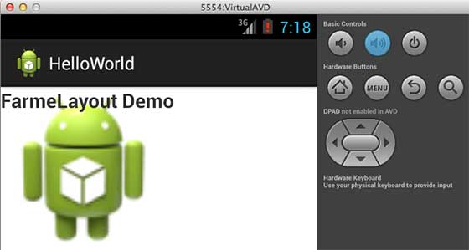
2. FrameLayout: Example
This XML example , the image is displayed on the center of Text view but at the left side of the frame layout

Slide 40
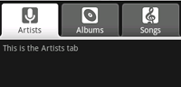
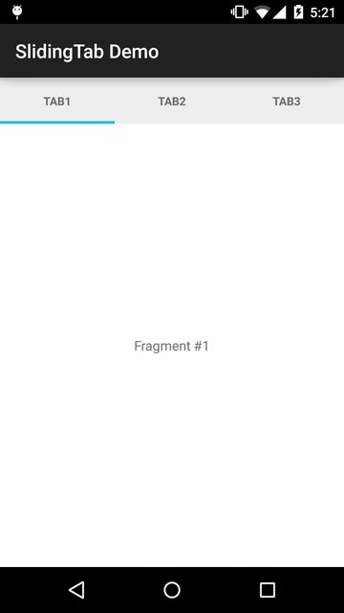
5. Tab Layout
A tab Layout has 2 main elements
1.Tab indicator e.g Label or Label and Icon
2. Content: Tab content e.g View or Activity

Slide 41
Loading Layout XML Resource
Android compiles the XML layout code that is later loaded in java code by the following method:
Public void oncreate (Bundle savedinstancesstate)
{ …..
Setcontentview(R.layout.<layout_file_name>);
… }

Slide 42
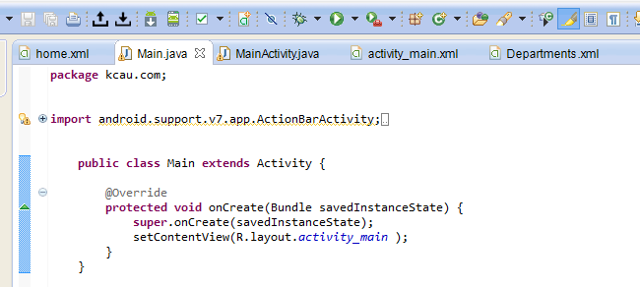
Loading Layout XML Resource
A layout file is referenced using the following syntax:
R.layout.<layout_file_name>
for instance, this example loads activity_main.xml file in the
onCreate() method

Slide 43
Terminologies of Views and view groups
Padding is the space inside the border, between the border and the actual view's content.
Margins are the spaces outside the border, between the border and the other elements next to the view.
Example:

Slide 44
Operations on views
Common operations that can be performed on Views are:
1. Set properties by putting values of attributes in the XML layout files. E.g. Layout_width=“fill parent”, Layout_height=“wrap content”
2. Set focus on view in response to user input by using requestFocus() method.
3. Set up listeners by putting listeners that will be notified when something interesting happens to the view control .For example, a Button notifies a listener to call clients when the button is clicked.
4. Set visibility by hiding or showing views using setVisibility(int) method

Slide 45

Thank You
Questions

